Slide 1

The Healthcare Gap
Delayed Care
Millions delay treatment due to uncertainty about symptom severity.
No Quick Triage
Lack of immediate assessment leads to missed early detection opportunities.
Overcrowded Clinics
Inefficient patient flow strains healthcare facilities.
Repetitive Assessments
Doctors spend valuable time on routine triage tasks.

Slide 2





Solution: Health AI
MedSense AI is a smart AI triage and doctor assist platform designed to streamline healthcare.
Analyzes Symptoms
Intelligently processes patient-reported symptoms.
Detects Emergencies
Identifies critical conditions instantly for rapid response.
Generates Health Reports
Creates clean, comprehensive PDF health reports.
Prioritizes Cases
Organizes cases by urgency for efficient doctor review.

Slide 3


High-Level System Workflow
AI Co-Pilot
Patient
Suggests next steps and actions
Provides symptoms and data
Doctor Dashboard
High-Level System Workflow
AI Triage Engine
Consolidates patient insights
Analyzes risk and prioritizes
PDF Report
Emergency Alerts
Generates documented summary
Notifies clinicians immediately
This workflow illustrates the journey from patient input through AI analysis to doctor assistance, ensuring seamless and efficient care.

Slide 4

Patient Workflow
01
02
Patient Enters Symptoms
AI Analyzes Severity
Users input their symptoms into the system.
The AI classifies symptoms into Low, Moderate, High, or Emergency.
03
04
Emergency Red Flags
PDF Report Generated
Critical indicators are detected immediately.
A detailed health report is created for the patient and doctor.
05
Case Appears on Dashboard
The case is instantly visible to the doctor for review.

Slide 5
Emergency Red Flag Detection
MedSense AI automatically identifies critical symptoms, triggering immediate alerts.
Chest Pain
Breathing Difficulty
Stroke Indicators
Fainting
Heavy Bleeding

Slide 6

Clinician Workflow
Dashboard Sorted by Risk
Cases are prioritized, making high-risk patients immediately visible.
Emergency Cases Highlighted
Urgent situations are clearly marked for quick action.
Case Details + PDF Preview
Doctors can access comprehensive patient information and reports.
Faster Triage, Faster Care
Streamlined process leads to more efficient and timely treatment.

Slide 7


AI Co-Pilot for Doctors
An optional Phase 3 feature, the AI Co-Pilot, enhances doctor efficiency.
Case Summary
SOAP Note Generator
Provides concise overviews of patient cases.
Automates the creation of Subjective, Objective, Assessment, and Plan notes.
Saves Documentation Time
Reduces administrative burden, allowing more focus on patient care.

Slide 8
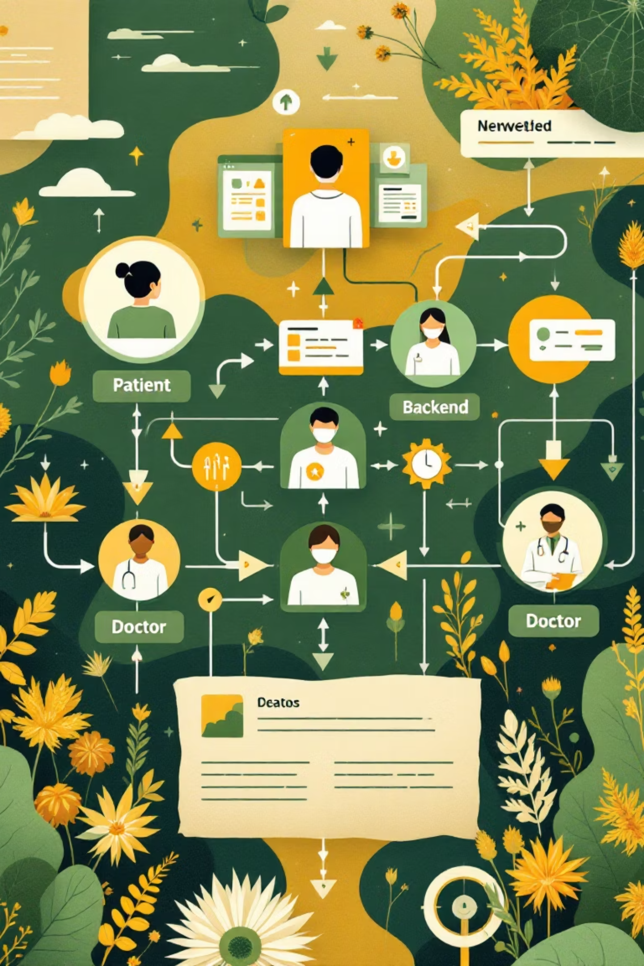
Full End-to-End Workflow
Patient Side
Backend
Doctor Side
Language selection
NLP symptom extraction
Dashboard & risk sorting
Symptom input (text/voice)
Emergency logic
Case details & report download
Reasoning engine
AI triage + red flag detection
AI co-pilot integration
PDF generator & case storage
PDF report & next steps

Slide 9



Impact: Health AI
Saves Lives
Early detection and rapid response to emergencies.
Reduces Hospital Load
Efficient triage prevents unnecessary clinic visits.
More Doctor Time
Frees up clinicians for critical care and complex cases.
Accessible Care
Extends healthcare reach to remote and underserved areas.
Health AI makes healthcare accessible, intelligent, and real-time — anytime, anywhere.

